Slide 1
A Clinical Look at Co-occurring Mental Health, Substance Use, and Physical Health Disorders
Thomas E. Freese, PhD
Pacific Southwest Addiction Technology Transfer Center UCLA Integrated Substance Abuse Programs
Semel Institute of Neuroscience and Human Behavior
UCLA David Geffen School of Medicine

Slide 2
What we’ll cover
Prevalence of co-occurring mental health, substance use, and physical health disorders
Review of drug categories
How drugs affect your brain and body
Strategies for working with clients with CODs
Tips to accommodate cognitive deficits
Behavioral health interventions for medical conditions

Slide 3
Redefining Co-Occurring Disorders
Client
Mental Health
Physical Health
Substance Use

Slide 4
Co-Occurring Disorders and your Clients
How do these individuals present?
What disorders are common?
What are the challenges working with them?
Notes:
“Your clients come in for MH, but how can we bring in these other areas that affect their mental health while still respecting they reason they came in?”

Slide 5
Co-Occurring Disorders Are Common
34 million American adults had both a mental and physical health disorder in past 12-months¹.
In 2013, over 8 million people had both a mental health and SUD² (ages 12+).
In 2013, about 2.3 million people had serious mental illness and SUD² (ages 18+).
MH
PC
34 million
MH
SU
8
million
SMI
SU
2.3
million
Druss, B.G., and Walker, E.R. (2011).
SAMHSA (2014)

Slide 6
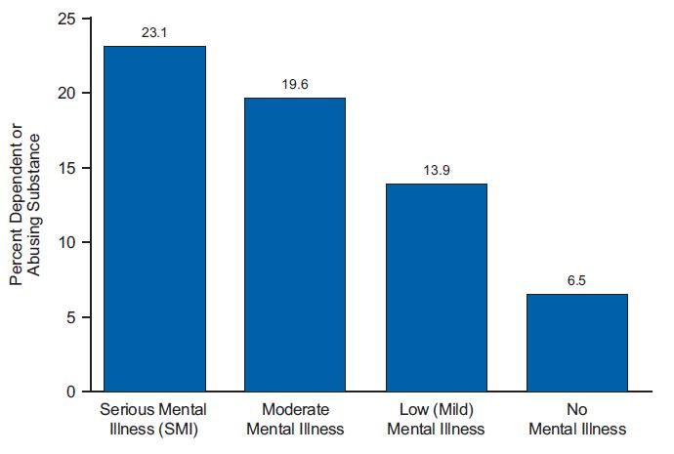
Past Year Substance Use and Severity of Mental Illness, 2013
SAMHSA, NSDUH 2013
Notes:
Past Year Substance Use Disorders among Adults Aged 18 or Older, by Level of Mental Illness: 2013
Levels of any mental illness (AMI) considered in this report include serious mental illness
(SMI), moderate mental illness, and low (mild) mental illness, which are differentiated by their
level of functional impairment. Functional impairment is the interference with or limitation of
one or more major life activities.

Slide 7
COD Prevalence Among Individuals with past-12 month SUD
Any Substance Use Disorder Any Substance Dependence
Grant et al., 2006; from National Epidemiologic Survey on Alcohol & Related Conditions
Grant et al., 2006; from National Epidemiologic Survey on Alcohol & Related Conditions

Slide 8
Most People with a Mental Health Disorder Also Have a Medical Condition
People w/ MH Disorder
(25% of adults)
People w/ Medical Conditions
(58% of adults)
68% of adults with MH dx also have a medical condition
29% of adults with a medical condition also have a MH disorder
Notes:
Clinicians are often used to asking the health questions on the assessment so they can complete the forms, but often they don’t think about how that can be affecting the client’s MH.
Clinicians often afraid to work outside of their scope of practice.
In the near future their clinics will be taking client’s blood pressure and adding that data to their charts.

Slide 9
Mental Health, Substance Use, and Physical Health are Interconnected
Pathways/causes are complex and multi-directional
Substance use can cause symptoms similar to mental health disorders
Mental health disorders can lead to substance use
Medical disorders can lead to MH & SU disorders (and vice versa)
Having one type of disorder is a risk factor for developing another
Druss, B.G., and Walker, E.R. (February 2011)
Notes:
Medical disorders may lead to mental disorders, mental conditions
may place a person at risk for medical disorders, and mental and medical disorders may
share common risk factors.
In addition to the high prevalence of these conditions, there is also evidence
that having each type of disorder is a risk factor for developing the other.
Example: The 12-month prevalence of major depression is about 5 percent in people without chronic medical conditions, compared with almost 8 percent in people with one
condition, 10 percent in people with two conditions, and 12 percent in people with three
or more medical conditions
medical conditions that are accompanied by a high symptom burden,
such as migraine headaches or back pain, can lead to depression (116). At the same time, major
depression is a risk factor for developing medical conditions, such as cardiovascular disease,
that are characterized by pain or inflammation

Slide 10
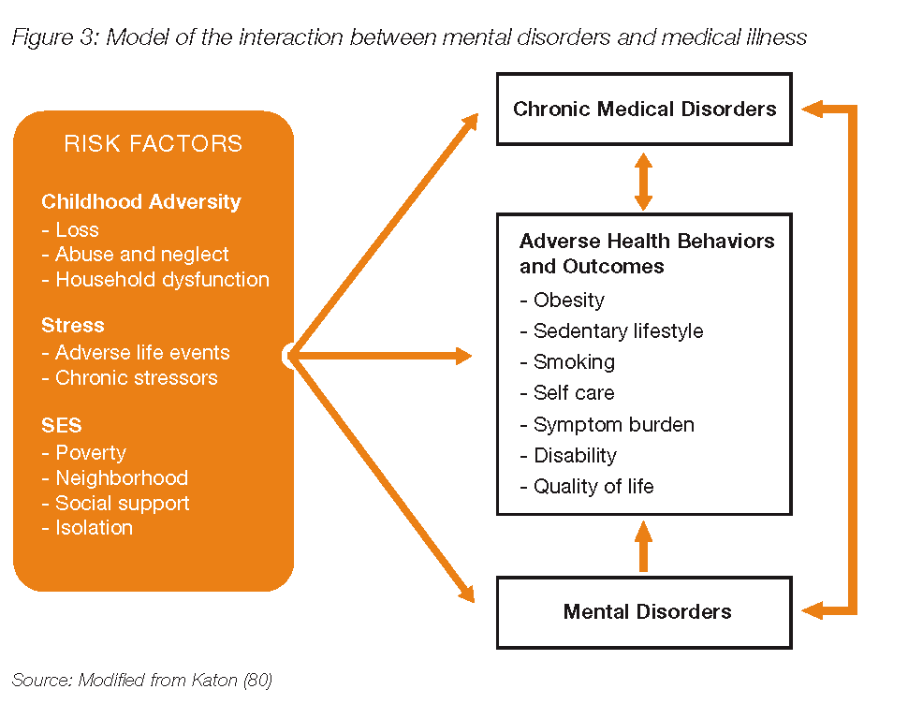
Mental Health, Substance Use, and Physical Health are Interconnected
Mental Health & Substance Use
Druss, B.G., and Walker, E.R. (February 2011).
Notes:
With all of this going on, what does it mean for our services? → Triage and intensive treatment at the very beginning is important.

Slide 11
The Challenge of CODs
Common disease treatments can make comorbid MH or medical problems worse
Antipsychotics & other psych meds can lead to weight gain, type 2 diabetes, and cardiovascular diseases.
Some meds for medical conditions have psych side effects or exacerbate MH symptoms
e.g., diuretics can cause anxiety and depressive symptoms
MH/SU symptoms can affect physical health
Paranoia can reduce usage of services
Disorganized thinking makes following medical treatments difficult
Both MH and SUD Impair self-care
Druss, B.G., and Walker, E.R. (February 2011).
Notes:
“Keep an eye out for these things, because they will get worse if not identified during screening and assessment.”
CAUTION: talking too much about psych med side effects might be out of their scope of practice.
“Be aware of so if you see these side effects, you can bring it up with the Physician and the Treatment team rather than directly with the client.” Avoids scope of practice concern.
Example intervention: made a list of medications you take and who prescribes them. Bring list to next primary care appointment.
nitrates and nitrites can cause anxiety, agitation, and hypomania
Self-care behaviors include
taking medication as prescribed and adhering to lifestyle modifications, which may include
exercise, diet and stress relief (103). Depression may decrease the motivation and energy needed
to perform self-management behaviors and may also adversely impact interpersonal relationships,
including collaboration with physicians (80).
An analysis of the claims-based 2001 Veterans
Affairs National Psychosis Registry found that people with severe mental illness often exhibit
poor adherence to both psychiatric medications and medications for medical conditions (121).

Slide 12
Adverse Effects of Co-Occurring Disorders
Behavior change more complex because clients often in different stages of change for each disorder¹.
Poorer medication and treatment adherence compared to those with SMI alone².
Motivational Interviewing can be used for any behavior change, improving client engagement in psychosocial and medical treatment, medication adherence, recovery activities, etc..
¹Brady et al., 1996.
²Ziedonis et al., 2005
³ DiClemente, Nidecker, & Bellack, 2008
Notes:
“Strong research evidence that co-occurring substance use significantly complicates psychiatric disorders in the following domains: relapse of psychiatric disorder, hospitalization, disruptive behavior, familial problems, housing instability, decreased functional status, HIV infection, and medication noncompliance” (Drake & Brunette, 1998).
Having multiple types of problems (e.g., depression, interpersonal, housing, SU) makes it more difficult to complete any single target change (Brady et al., 1996).

Slide 13
Consequences of MH Disorders
In the USA and Canada, mental health disorders account for 25% of all years of life lost to disability and premature mortality¹
Among those who die by suicide, more than 90% have a diagnosable disorder⁴.
In 2008, suicide was the tenth leading cause of death in the USA⁶.
People with serious mental illness die about 25 years earlier (on average) than the general population.
Notes:
World Health Organization. (2004). The world health report 2004: changing history. Annex Table 3. A126-A127. Geneva: WHO.
Kessler RC, et al. (2005). Archives of General Psychiatry, 62: 617-627.
US Department of Health and Human Services. (1999). Mental health: a report of the Surgeon General. Rockville, MD: US Department of Health and Human Services, 1999.
Minino AM, et al. (2011). Final Data for 2008. National Vital Statistics Reports 2011; 59(10): 01-127. Available: http://www.cdc.gov/nchs/data/nvsr/nvsr59/nvsr59_10.pdf.

Slide 14
Why Is Integration Important?
Adults with serious mental illness die 25 years earlier, largely as a result of treatable medical conditions (NAMI, 2013)
Adults with SUD die 26 years earlier, again due to physical health problems related to their long-term substance use (LA County, 2015)
Serious mental illness costs America $192.2 Billion per year in lost earnings. (NAMI, 2013)
27 physical illnesses occur more often in patients with alcohol addiction including the liver, pancreas, airways, gastrointestinal tract, and nervous system. (Medical News Today, 2015)

Slide 15
Why focus on COD?
Clinic redesign initiatives are underway, including implementing care clinics and health navigators.
Mental health and substance use services are integral to health care services. The goals of DMH initiatives are:
Ensure positive experiences of care
Enhance customer services
Ensure care is effective
Develop bi-directional care/behavioral health homes
Implement data outcomes system to enable monitoring of client progress
Control/reduce costs
Develop strategies to extend care
Develop strategies to reduce readmission and preventable hospitalizations
Notes:
- “We’re not asking MH clinicians to diagnose and treat medical conditions, but we want you to be aware of the signs and symptoms. Awareness also of mental health interventions that can improve physical health.
- It’s not out of your scope of practice to ask a client if they made it to their primary care appointment.

Slide 16
The Science of Addiction
Notes:
Why is it hard to stop using a substance?

Slide 17
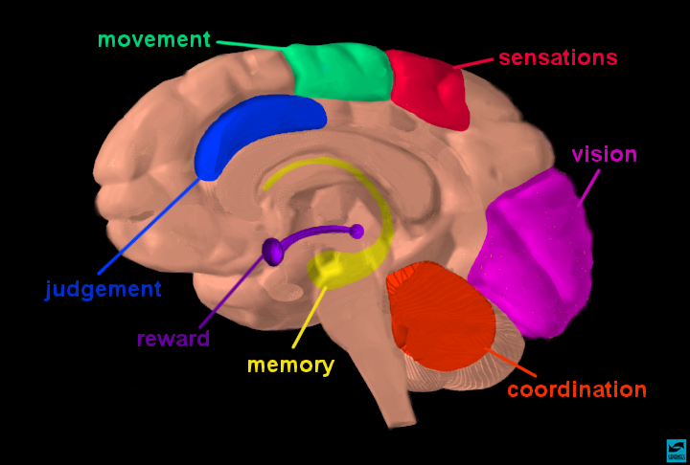

Slide 18
Pathway for Understanding Addictive Effects of Drugs on the Brain & Behavior
Reward Pathway
Notes:
Let’s move into the brain to see how addictions develop and the neurotransmitters at play in this process.

Slide 19
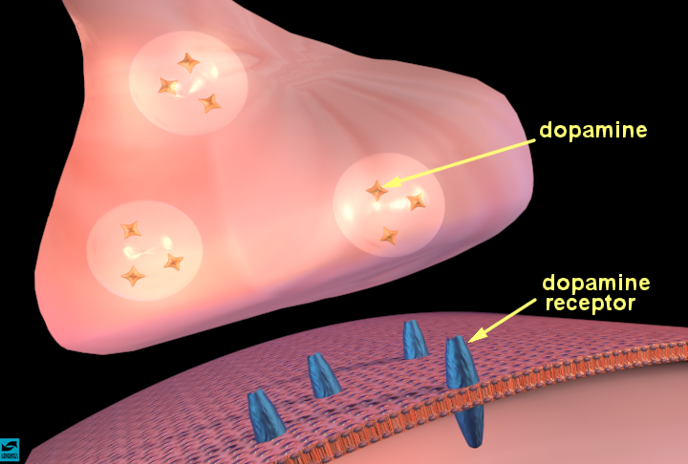

Slide 20
Dopamine and the Brain
Notes:
20

Slide 21
Natural Rewards Elevate
Dopamine Levels
FOOD
SEX
200
200
NAc shell
150
150
DA Concentration (% Baseline)
100
100
15
% of Basal DA Output
Empty
10
50
Copulation Frequency
Box
Feeding
5
0
0
0
60
120
180
Scr
Scr
Scr
Scr
Time (min)
Bas
Female 1 Present
Female 2 Present
Sample
Number
1
2
3
4
5
6
7
8
9
10
11
12
13
14
15
16
17
Mounts
Intromissions
Ejaculations
Source: Di Chiara et al.
Source: Fiorino and Phillips
Notes:
This slides shows the dopamine output compared to baseline in an animal model. Looking at the red line above, with 100 as baseline, when a male rat is fed, his dopamine output spikes and increases 50% (from 100 to 150). The slide on the right shows that during sexual activity, a male rat’s dopamine output spikes to 200, from 100 (100% increase).

Slide 22
Methamphetamine and Dopamine

Slide 23
Drugs Also Bring Reward (via Dopamine)
250
Accumbens
ETHANOL
250
NICOTINE
200
200
150
% of Basal Release
% of Basal Release
150
100
100
0
0
0
1
2
3 hr
0
1
2
3
4hr
Time After Nicotine
Time After Ethanol
COCAINE
1500
1000
500
0
METHAMPHETAMINE
400
Accumbens
Accumbens
300
% of Basal Release
200
% Basal Release
100
0
0
1
2
3
4hr
0
1
2
3hr
Time After Cocaine
Time After Methamphetamine
Source: Shoblock and Sullivan; Di Chiara and Imperato

Slide 24
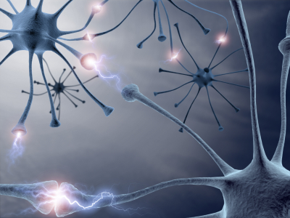
Prolonged Drug Use Changes The Brain In Fundamental and Long-Lasting Ways

Slide 25
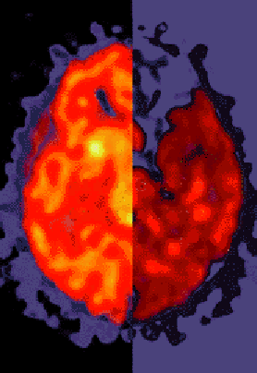
BRAIN CHANGES appear prominently in PET scans of current and past drug users Drug users have far less dopamine activity (right), as is indicated by the depletion (dark red shows disruption), compared to the controls (left) Studies show that this difference contributes to dependence and a diseased brain
Notes:
While in the short term, dopamine output is enhanced through use of drugs/alcohol, long-term use of substances can contribute to depletions and deficits in dopamine production/manufacturing and activity in the brain. This slide shows what normal dopamine activity looks like in a PET scan (left half of brain image), as compared to the dopamine activity of a chronic substance user (right half of brain image).
Horizontal view.

Slide 26
Cognitive and
Memory Effects

Slide 28
Cognitive Effects of Chronic Substance Use
General effects of most substances:
Episodic memory
Emotional processing
Executive functions (e.g., planning and decision making)
Specific effects:
Alcohol and Psychostimulants: impulsive action and cognitive flexibility
Alcohol and MDMA: spatial processing, perceptual speed, and selective attention
Cannabis and Methamphetamine: prospective memory
Cannabis and MDMA: processing speed and complex planning.

Slide 30
Control > MA
4
3
2
1
0

Slide 31
MA >
Control
5
4
3
2
1
0

Slide 32
Memory Difference between Stimulant and Comparison Groups

Slide 33
What does this mean for the clients that you work with?

Slide 34
Strategies for Cognitive Impairment
Reducing substance use may be more acceptable than total abstinence
Any reduction in use is progress
Affirm early successes to enhance self-efficacy
When beginning tx & during early recovery, clients often feel worse before they feel better
Educate client to anticipate changes in mood, symptoms, lifestyle, and peer relations
(Carey et al., 1996)

Slide 35
Strategies for Cognitive Impairments
MODIFY TREATMENT PROTOCOLS
Decrease length of sessions (attention, memory)
Take structured breaks (attention, focus, memory)
Increase session frequency (practice)
Repeat presentations of therapeutic information (detox, 2 weeks, 4 weeks, 1 month, 3 months, etc.)
Multi-modal presentations—audio, visual, experiential, verbal, hot/cold situations, etc.
How could you do this at your clinic?
Bates, et al., 2013; Huckans, et al., 2013
Grohman, K. & Fals-Stewart, W., 2003, 2012; Medalia, A. & Revheim, N., 2003; & Aharonovich, E., et al., 2003, 2005, 2011
Notes:
“If you only have 1 COD group, what other groups could incorporate SU?”

Slide 36
Strategies for Cognitive Impairments
Use memory aids— calendars, planners, phone apps, diagrams
Teach stress management, breathing, relaxation, and mindfulness meditation skills
Provide immediate feedback and corrective experiences
Repeat instructions, put things in writing, provide short/direct instructions

Slide 37
Chronic Medical Conditions and Behavioral Health
Shifting to a Whole Health Perspective

Slide 39
Disease Burden Mostly Due to Preventable Causes
People with serious mental illness die about 25 years earlier (on average) than the general population.
Most common causes of death:
Cardiovascular disease
Diabetes
Respiratory disease (e.g., pneumonia, influenza)
Infectious disease (e.g., HIV/AIDS)
Common risk factors
Smoking
Alcohol
Poor nutrition
Lack of exercise
Risky sexual activities
IV drug use
Druss, B.G., and Walker, E.R. (February 2011). Mental Disorders and Medical Comorbidity. Research Synthesis Report No. 21. Princeton, NJ: The Robert Wood Johnson Foundation.
Notes:
Druss, B.G., and Walker, E.R. (February 2011). Mental Disorders and Medical Comorbidity. Research Synthesis Report No. 21. Princeton, NJ: The Robert Wood Johnson Foundation.

Slide 40
Chronic Medical Conditions that commonly co-occur with Behavioral Health

Slide 41
Diabetes

Slide 42
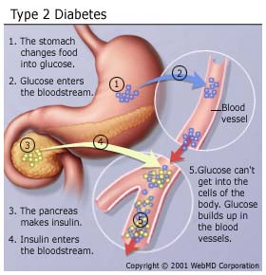
Type 2 Diabetes Overview
Basic Overview:
Metabolic disease.
Hyperglycemia (too much sugar) due to insulin resistance and defects in insulin secretion.
Diabetes can lead to:
blindness
heart & blood vessel disease
stroke
kidney failure
amputations
nerve damage.
http://safediabetes.blogspot.com/2010/12/how-to-reduce-impact-type-2-diabete.html

Slide 43
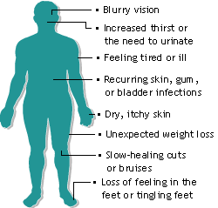
Sign & Symptoms
Often no symptoms at all.
Most common symptoms include:
Blurred vision
Erectile dysfunction
Fatigue
Frequent or slow-healing infections
Increased appetite
Increased thirst
Increased urination
http://www.thetype2diabetesdiet.com/wp-content/uploads/2009/03/symptoms-for-type-2-diabetes.gif

Slide 44
Type 2 Diabetes
Relationship with SUD
Heavy alcohol consumption can increase risk factors including: body-mass index, low HDL (“good”) cholesterol and cigarette smoking ¹.
A history of substance use is associated with earlier age of onset of diabetes ².
SUD is associated with increased mortality in diabetics ³.
Significance of Behavioral Health
Co-occurring depression is common.
Both diet control and depression respond to behavioral activation strategies.
Some psych meds can contribute to increased blood sugar and other risk factors
¹ Tsumura, 1999.
² Johnson, 2001.
³ Jackson, 2007.

Slide 45
Type 2 Diabetes & Your Clients
Social support for abstinence can increase linkage to medical services ².
Encourage activities that improve diabetes:
Better diet.
Reduce simple carbohydrate intake (i.e. potatoes, white bread, corn, soda, candy, sweets).
More exercise.
Maintain regular appointments with doctor overseeing diabetes treatment.
¹ Friedmann, 1999.
² Saitz, 2004.

Slide 46
Hypertension
Common Medical Issues Associated with Mental Health and Substance Use Disorders

Slide 47
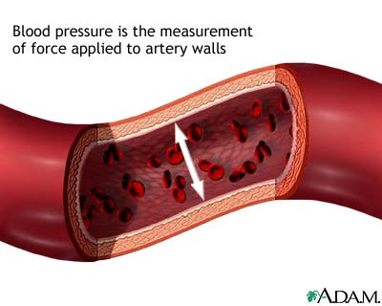
Hypertension: Clinical Description
Blood pressure (BP) is the force against the walls of one’s arteries while blood is pumping.
Hypertension is when BP is too high.
Example BP: 120/80 mmHg (“120 over 80”)
Systolic (top number): pressure while heart contracts.
Normal is <120. High is >180.
Diastolic (bottom number) pressure while heart relaxes & enlarges.
Normal is <80. High is >80.

Slide 48
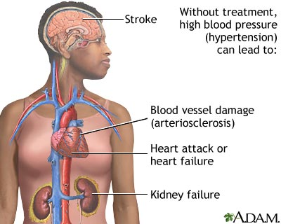
Consequences of Hypertension (HTN)
Increased risk of:
Stroke
Blood vessel damage (arteriosclerosis)
Heart attack
Tearing of heart’s inner wall (aortic dissection)
Vision loss
Brain damage
(NIH, 2010)

Slide 49
Blood Pressure Link to SUD
Three or more drinks per day increases BP & risk of hypertension in both women and men¹.
Decreasing alcohol consumption associated with dose-dependent reduction in BP ².
Stimulants like cocaine or amphetamines can cause HTN and other acute and chronic cardiovascular diseases ³.
HTN risk associated with quantity of cigarettes smoked daily and the duration of smoking ⁴.
Former smokers have higher rates of hypertension than those who never smoked ⁴.
¹ Sesso, 2008.
² Xin, 2001.
³ McMahon, 2010.
⁴ Orth, 2004.
Notes:
Ask about alcohol consumption. Encourage limiting to 2 or less drinks per day.
If client smokes, give advice and support to quit smoking (NICE, 2006).
Encourage weight loss and salt reduction.
Losing 10kg (22 lbs) can reduce systolic BP by 10 points (Cappuccio, 2007).

Slide 50
Starting the Conversation
Start the conversation by bringing up any indication of substance use
1. Initial assessment questions
2. Physical Health symptoms
3. History
“Would it be okay if I share some feedback with you?”
Notes:
Click to animate in Item 1
Once you have permission, you start by helping the patient understand the scoring for the instrument.
Click to animate in Item 2
At minimum, provide the range of scores and some context for understanding them.
Click to animate in Item 3
Then, give the score
Click to animate in Item 4
and explain what the score means in terms of their relative level of risk.
Click to animate in Item 5
Next, relate the patient’s substance use (drinking or drug use) to the norms in the larger population. Normative information can be powerful because many people, particularly college students, believe that everyone in college drinks a lot when in fact many students do not drink or use drugs. Sharing information about norms can help patients get an accurate picture of social norms and realize that their level of use may be above average.
Click to animate in Item 6
Finally, ask you patient for her reaction to the score and any feedback.

Slide 51
Now What Do I Do?
Meet the client where they are.
Finding a Hook
Ask the client about their concerns
Provide non-judgmental feedback/information
Watch for signs of discomfort with status quo or interest or ability to change
Always ask question: “What effect, if any, do you think alcohol has on your health?
Let the client decide.
Just asking the question is helpful.

Slide 52
1. Precontemplation
Definition:
Not yet considering change or
is unwilling or unable to change.
Primary Task:
Raising Awareness—Connect SU and MH Sxs
6. Recurrence
Definition:
Experienced a recurrence
of the symptoms.
Primary Task:
Cope with consequences , relate to MH functioning as precursor and outcome
2. Contemplation
Definition:
Sees the possibility of change but
is ambivalent and uncertain.
Primary Task:
Resolving ambivalence/
Helping to choose change
Stages of Change: Primary Tasks in Linking to Mental Health
5. Maintenance
Definition:
Has achieved the goals and is
working to maintain change.
Primary Task:
Develop new skills to maintain improvements in MH and SU
3. Determination
Definition:
Committed to changing.
Still considering what to do.
Primary Task:
Help identify appropriate strategies to improve MH/ reduce SU
4. Action
Definition:
Taking steps toward change but
hasn’t stabilized in the process.
Primary Task:
Help implement change strategies
to decrease MH Sxs and SU
Updated 4/14/2014
Notes:
I added a dashed line to Recurrence, since “recurrence” has a unique place in the stages.
I added numbers to the stages so it’s clear where to start.

Slide 53
Stages of Change: Linking SU Interventions to MH Goals
Offer factual information about MH-SU connection Explore the events that brought them to treatment—Impact of SU/MH Explore results of previous efforts to improve MH. What was the role of SU? Explore pros and cons of improving MH and decreasing SU | Explore the person’s sense of self-efficacy to reduce MH symptoms Explore expectations about change—What is the role of SU on MH Sxs? Summarize self-motivational statements for change in MH and SU Continue exploration of pros and cons of improving MH and decreasing SU | Offer menu of options for addressing MH Sxs and SU Help identify pros and cons of various change options Identify and lower barriers to change Help enlist social/peer support Encourage person to publicly announce plans to change
Support a realistic view of change through small steps Identify high-risk situations for SU and impact of use on MH functioning Develop coping strategies Assist in finding new reinforcers of positive change including feeling better Help access family/social/peer support | Help identify and try supportive behaviors and drug-free activities to maintain goals. Maintain supportive contact and highlight progress in maintaining improved functioning--What was the role of SU? Set new short and long term goals for MH and SU | Frame recurrence as a learning opportunity—What was the impact on MH? Explore possible psychological, behavioral and social antecedents Help to develop alternative coping strategies for strong emotions Encourage person to stay in the process and maintain support
1. Pre- contemplation
2.
Contemplation
3.
Determination
4.
Action
5.
Maintenance
6.
Recurrence
Notes:
I added an “s” to “Stage” in the title
I added “Side 2” at the bottom
I changed “him/her” to “person” in 3rd bullet under Recurrence
I removed all of the borders on the oval shapes (to match side 1), except for Recurrence, which I changed to dashes.
I aligned the bullet points
I had a problem with fitting everything in the Recurrence box. So I changed the “and” to “&” in bullet 4.
53

Slide 54
Behavioral Intersections & Interventions
Substance use
Raise awareness of interactions
Reduce substance use
Supportive behaviors and drug-free activities
Identification of new coping skills
Set new short and long term goals for MH and SU
Relapse prevention
Medication-Assisted Treatment (MAT)
Diabetes
Blood sugar monitoring and control
Identify and support dietary changes.
Promote self mgt.
Enhance mood stability
Stress Reduction

Slide 55
Behavioral Intersections & Interventions
Obesity
Monitoring food/diet
Goal identification and attainment
Exercise goal identification and tracking
COPD
Identifying Triggers
Smoking cessation (medical and behavioral)
Medication compliance
Daily Monitoring, Action Planning
Social support
Identify drug free activities including 12-step, church, and recreation

Slide 56
BEHAVIORAL HEALTH UTILIZATION
Medical Diagnosis Behavioral Health Intervention
Hypertension | Relaxation skills training, breathing, problem solving
Diabetes | Promote goal identification and attainment, enhance mood stability, identify and restructure alarmist thinking, stress reduction
Chronic Pain (multiple presentations), including fibromyalgia syndrome | Promote the use of attention diversion techniques, relaxation skills, stages of pain, values clarification
Obesity | Promote goal identification and attainment, behavioral modification, support healthy lifestyle attainment, motivational change, diet/exercise, motivation for change

Slide 57
BEHAVIORAL HEALTH UTILIZATION
Medical Diagnosis
Behavioral Health Intervention
Insomnia; Sleep Disturbances | Sleep Hygiene, Relaxation Skills Training
Fatigue/Malaise | Sleep Hygiene, Motivation for Change, Lifestyle Assessment and Planned Activity Guidance
Asthma | Identifying Triggers, Trigger Removal or Mgt., Daily Monitoring, Action Planning
Headache | Headache impact log, Trigger Identification
Pregnancy | Stress mgt., augment positive support, promote emotional and physical self care
Noncompliance with Medical Treatment | Motivational Interviewing, Strengths Identification, Strengths utilization, Values Inventory/Utilization
Hypercholesterolemia | Lifestyle Mgt., Diet/Exercise Goal Identification and Attainment, Motivation for Change

Slide 58
BEHAVIORAL HEALTH UTILIZATION
FOR OB/GYN
Medical Diagnosis
Behavioral Health Intervention
Pregnancy | Stress mgt., augment positive support, Emotional/Physical Self Care
Teen Pregnancy | Safety assessment, Resource assessment, Assessment of emotional/support needs
Post Partum Visit | Assessment and support for Post Partum Depression and adjustment issues
Gestational Diabetes | Promote Self Mgt. Goal Identification and Attainment, Enhance mood stability, Identify and restructure alarmist thinking and hopelessness, Stress Reduction
SAB | Crisis intervention, grief work
Low Libido | Relaxation skills, Stress management, Relationship skills training, Communications skills training,
Infertility | Stress Management, Relationship skills training, Grief work
Noncompliance with Medical Treatment | Motivational Interviewing, Strengths Identification, Strengths utilization, Values Inventory/Utilization

Slide 59
Thank You!!
Joy Chudzynski, PsyD
joychud@ucla.edu
Grant Hovik, MA
ghovik@ucla.edu
Andrew Kurtz, MFT
ASKurtz@mednet.ucla.edu
www.uclaisap.org/dmhcod

